Slide 1
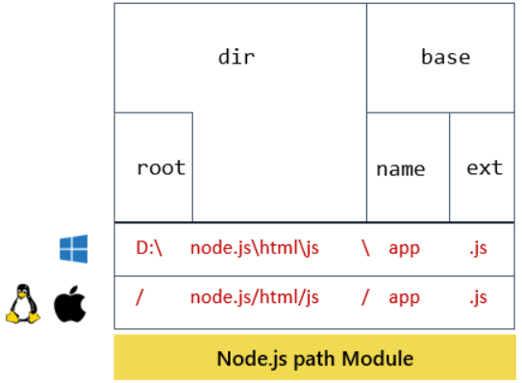

PATH MODULE IN NODE JS
The Path Module in Node.js provides the utilities/WAY for working with file and directory paths.
Accessed USING : CONST PT = REQUIRE(‘path’);

Slide 2
BUILTIN INTERFACE/METHODS OF PATH
NAMES | USAGE
path.dirname() | It is used to get the directory name of the given path.
path.extname() | It is used to get the extension portion of a file path. The extension string returned from the last occurrence of a period (.) in the path to the end of the path string. If there are no periods returns empty string.
path.basename() | It IS used to get the filename portion of a path to the file.
path.parse() | It is used to return an object whose properties represent the given path.
path.isAbsolute() | It is used to check whether the given path is an absolute path or not. path that contains the complete details needed to locate a file
path.delimiter | It is used to get platform-specific path delimiter.

